Slide 1
Co-piloting the Copilots: Fusing Large Language Models with Completion Engines for Automated Program Repair
Authors = [‘Yuxiang Wei Chunqiu’, ‘Steven Xia’ , ‘Lingming Zhang’] Conference = “ESEC/FSE 2023: Proceedings of the 31st ACM Joint European Software Engineering Conference and Symposium on the Foundations of Software Engineering”
Presented By = [ ‘Soon Song Cheok’ , ‘Aakash Kulkarni’]

Slide 2
Introduction
Automatic Program Repair (APR) existed for some time now. But there is no APR which can fix all the patches right.
Template based APR tools which uses templates, they can only fix the bug types within the preset templates and cannot generalize to new bug types
Then there are Neural Machine Translation (NMT) models to translate buggy code into correct code by learning from pairs of buggy and fixed code scraped from open-source commits. But it depends on the training set size and also may contain irrelevant or noisy commits

Slide 3
Introduction
Out of all APR techniques Large Language Models (LLMs) have shown to generate better patches then the existing APR techniques.
The reason is that modern LLMs often include large amounts of available open-source code repositories as part of their training dataset.
But even with LLMs, the patches generated are not always correct for the given context or situation.

Slide 4
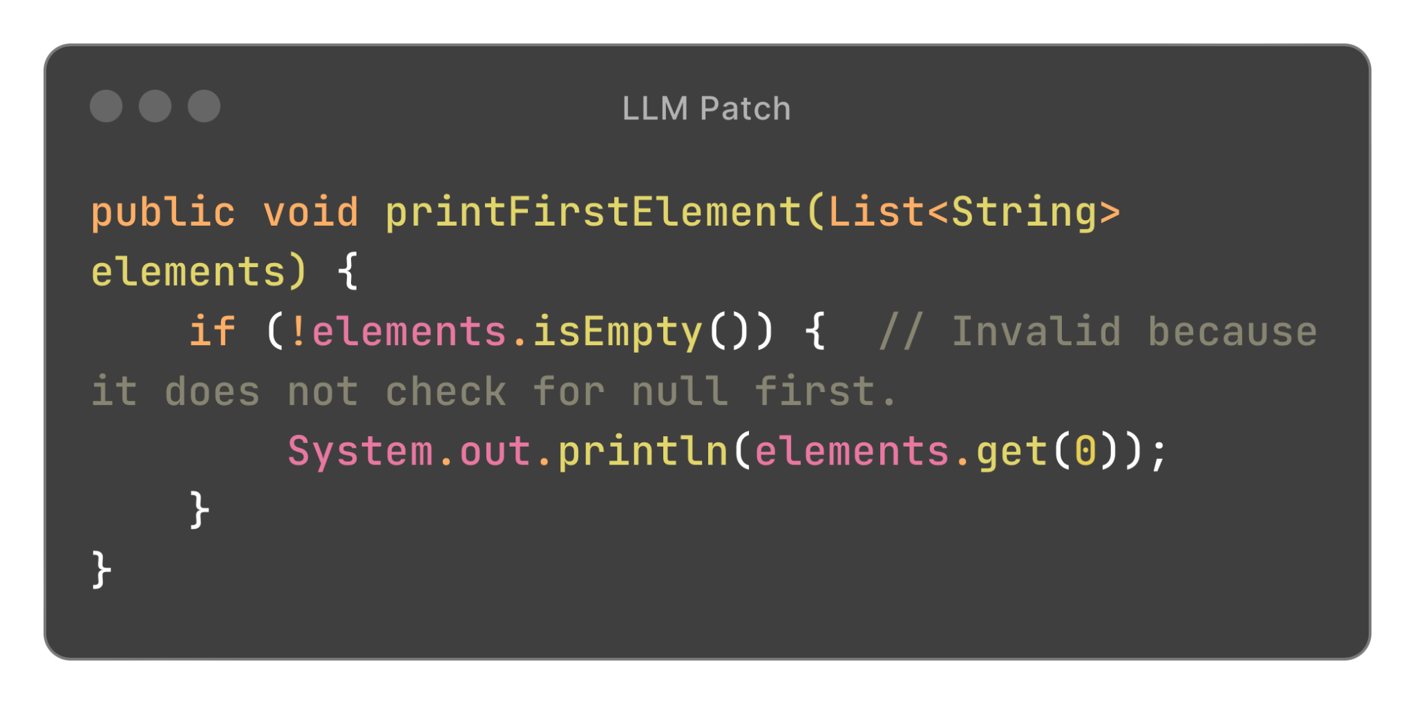
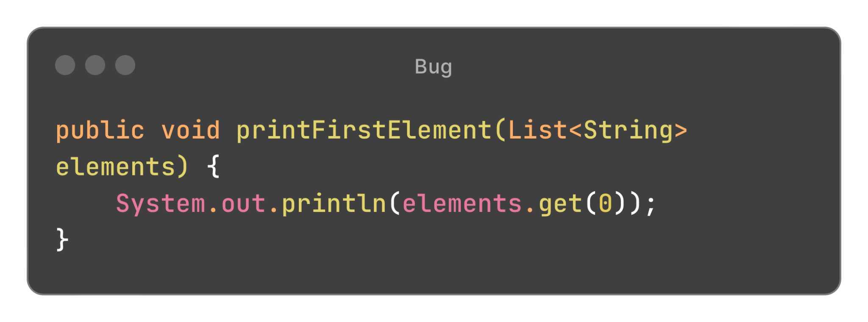
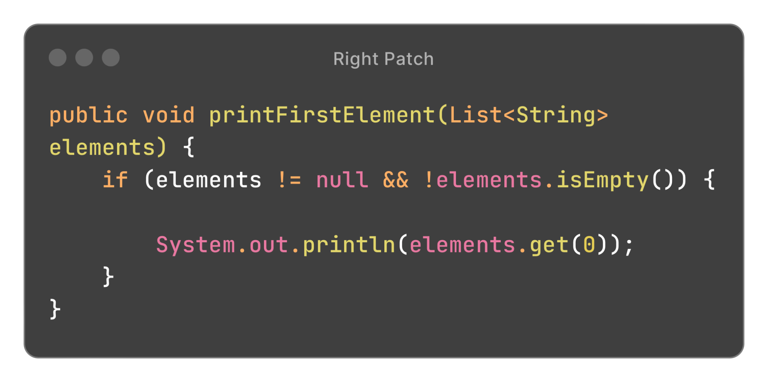
Example of Invalid Patch
Bug
LLM Patch
Right Patch
Notes:
Why is the Patch Invalid?
The patch checks if the list is empty before attempting to access an element, which seems logically correct and would indeed prevent an IndexOutOfBoundsException if elements is not null. However, this patch will still throw a NullPointerException if elements is null because it attempts to call isEmpty() on a null object.

Slide 5
Problem Statement
LLMs treat programs as sequences of tokens, meaning that they are ignorant of the underlying semantics constraints of the target programming language.
This results in plenty of statically invalid generated patches, impeding the practicality of the technique.
Like in the previous example, they are more likely to give the patches which are right syntactically, but not semantically.

Slide 6
Solution
The paper aims to improve APR by addressing the limitations of LLMs that generate syntactically correct but often semantically incorrect patches.
“Repilot” enhances automated program repair by fusing LLMs with a Completion Engine to generate more accurate and contextually appropriate software patches.

Slide 7
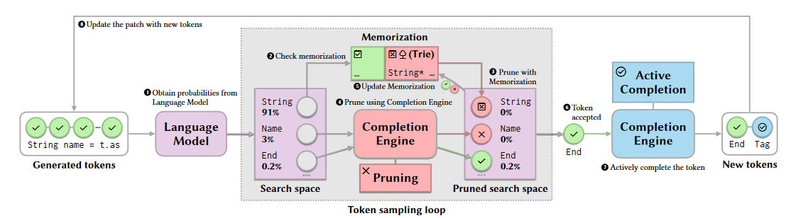
Approach
Notes:
The loop starts applying the current generation as the input to the language model ( 1 ), which returns a search space of a mapping from a suggested next token to its probability.
Repilot then enters a token selection phase that repeatedly samples a token from the search space, check- ing its feasibility, and pruning the search space until a token is accepted. Every time a token is sampled, Repilot first checks if it hits the memorization ( 2 ),
which stores the tokens that are known to be feasible or infeasible. The memorization of infeasible tokens includes the use of a prefix tree data structure (Trie) discussed in. When the token hits the memorization and is infeasible, the search space is pruned by setting this token’s probability to zero ( 3 ),
and the next sampling will run on the updated search space. In this way, the same token is not sampled again during the token selection phase. If the token misses the memorization, the search space is pruned under the guidance of the Completion Engine ( 4 ),
which we elaborate in. Provided that the sampled token is re- jected by the Completion Engine, Repilot zeroes out its probability. Otherwise, it is accepted and this token selection process terminates. The memorization gets updated in both cases ( 5 ).
After a token is accepted ( 6 ), we further leverage the Completion Engine, trying to actively complete the token ( 7 ).
The active completion, discussed in §4.4, may either produce more tokens or add noth- ing to the accepted token. Finally, Repilot appends all the newly generated tokens to the current generation and begins a new loop until a complete patch is generated. The loop stops when the model generates the special token end-token.

Slide 8
Completion Engine - Pruning
Each token generated by the LLM is assessed for its syntactical and semantical correctness within the context of the existing code, using static analysis and rules derived from the programming language’s syntax and semantics.
Tokens that violate syntactic rules or do not fit semantically within the code context are pruned or discarded, preventing them from becoming part of the final patch.
The pruning process influences the probability distributions used by the LLM for future token generations, steering the model away from similar invalid suggestions and enhancing the overall accuracy of the generated patches

Slide 9
Memorization
Memorization involves storing information about previously encountered tokens and their validation outcomes.
By caching these outcomes, the system can rapidly determine the feasibility of tokens in similar future scenarios without needing to reprocess them entirely.
Over time, this memorization helps the system learn from its past actions, reducing computational overhead and improving the efficiency of the token generation and pruning process.
Notes:
Memorization involves storing information about previously encountered tokens and their validation outcomes. This includes recording which tokens have been deemed valid or invalid in specific code contexts, allowing the system to quickly reference past decisions.
By caching these outcomes, the system can rapidly determine the feasibility of tokens in similar future scenarios without needing to reprocess them entirely. This significantly speeds up the patch generation process, as the Completion Engine can reuse insights from previous evaluations.
Over time, this memorization helps the system learn from its past actions, reducing computational overhead and improving the efficiency of the token generation and pruning process. It also aids in fine-tuning the model’s predictive capabilities by providing a rich dataset of token outcomes to learn from.

Slide 10
Completion Engine - Active Completion
Active Completion involves the Completion Engine not only validating and pruning the outputs from the LLM
But also proactively suggesting additional tokens or completions that are contextually appropriate.
Active Completion influences the LLMs subsequent outputs by providing it with feedback on the appropriateness of the suggested tokens.
Notes:
Suggesting Contextually Appropriate Tokens: Active Completion involves the Completion Engine not only validating and pruning the outputs from the Large Language Model (LLM) but also proactively suggesting additional tokens or completions that are contextually appropriate. This ensures that the patches not only avoid errors but also enhance the functionality and coherence of the code.
Enhancing Code Suggestions: By understanding the deeper structure and semantics of the code, such as data types, function signatures, and control structures, Active Completion can provide suggestions that fit seamlessly into the existing code. These suggestions are based on static and dynamic analysis of the codebase, ensuring that they are both syntactically correct and semantically meaningful.
Guiding the LLM Towards Optimal Solutions: Active Completion influences the LLM’s subsequent outputs by providing it with feedback on the appropriateness of the suggested tokens. This guidance helps steer the LLM towards generating more accurate and contextually relevant patches in future iterations, improving the overall effectiveness of the automated program repair process.

Slide 11
Research Questions
RQ1: How does Repilot’s bug fixing capability compare with state-of-the-art APR techniques?
RQ2: How effective is Repilot in improving the compilation rate of patch generation?
RQ3: Are all components of Repilot making positive contributions to its effectiveness?
RQ4: Can Repilot generalize to different subjects of bugs and models?

Slide 12
Research Questions
RQ1: How does Repilot’s bug fixing capability compare with state-of-the-art APR techniques?
RQ2: How effective is Repilot in improving the compilation rate of patch generation?
RQ3: Are all components of Repilot making positive contributions to its effectiveness?
RQ4: Can Repilot generalize to different subjects of bugs and models?

Slide 13
Research Questions
RQ1: How does Repilot’s bug fixing capability compare with state-of-the-art APR techniques?
RQ2: How effective is Repilot in improving the compilation rate of patch generation?
RQ3: Are all components of Repilot making positive contributions to its effectiveness?
RQ4: Can Repilot generalize to different subjects of bugs and models?

Slide 14
Research Questions
RQ1: How does Repilot’s bug fixing capability compare with state-of-the-art APR techniques?
RQ2: How effective is Repilot in improving the compilation rate of patch generation?
RQ3: Are all components of Repilot making positive contributions to its effectiveness?
RQ4: Can Repilot generalize to different subjects of bugs and models?

Slide 15
Research Questions
RQ1: How does Repilot’s bug fixing capability compare with state-of-the-art APR techniques?
RQ2: How effective is Repilot in improving the compilation rate of patch generation?
RQ3: Are all components of Repilot making positive contributions to its effectiveness?
RQ4: Can Repilot generalize to different subjects of bugs and models?

Slide 16
Evaluation Setup
Single-hunk repair setting
Assume Perfect Fault Localization

Slide 17
Evaluation Setup
Datasets Used
Single-hunk repair setting
Assume Perfect Fault Localization
Defects4J 1.2
Defects4J 2.0

Slide 18
Evaluation Setup
Datasets Used
Single-hunk repair setting
Assume Perfect Fault Localization
Defects4J 1.2 (135 bugs)
Defects4J 2.0 (138 bugs)

Slide 19
Evaluation Metrics
Plausible Patches: Patches that passed all test cases but violated user intent
Correct Patches: Patches that are semantically equivalent to the developer patches
Patch compilation Rates: Percentage of the compilatable patches in all generated patches

Slide 20
Evaluation Metrics
Plausible Patches: Patches that passed all test cases but violated user intent
Correct Patches: Patches that are semantically equivalent to the developer patches
Patch compilation Rates: Percentage of the compilatable patches in all generated patches

Slide 21
Evaluation Metrics
Plausible Patches: Patches that passed all test cases but violated user intent
Correct Patches: Patches that are semantically equivalent to the developer patches
Patch compilation Rates: Percentage of the compilatable patches in all generated patches

Slide 22
Evaluation Metrics
Plausible Patches: Patches that passed all test cases but violated user intent
Correct Patches: Patches that are semantically equivalent to the developer patches
Patch compilation Rates: Percentage of the compilatable patches in all generated patches

Slide 23
RQ1: How does Repilot’s bug fixing capability compare with state-of-the-art APR techniques?

Slide 24
RQ1: How does Repilot’s bug fixing capability compare with state-of-the-art APR techniques?
NMT based :
CoCoNut DLFix CURE RewardRepair Recorder

Slide 25
RQ1: How does Repilot’s bug fixing capability compare with state-of-the-art APR techniques?
NMT based :
CoCoNut DLFix CURE RewardRepair Recorder
Template Based:
PraPR TBar

Slide 26
RQ1: How does Repilot’s bug fixing capability compare with state-of-the-art APR techniques?
NMT based :
CoCoNut DLFix CURE RewardRepair Recorder
Template Based:
PraPR TBar
LLM Based:
Alpha Repair
Repilot (proposed approach)

Slide 27
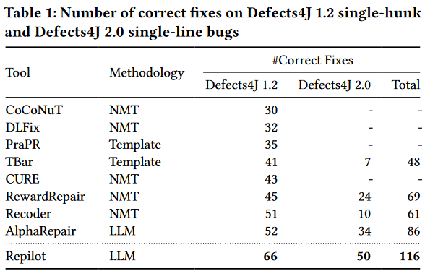
RQ1: How does Repilot’s bug fixing capability compare with state-of-the-art APR techniques?

Slide 28
RQ1: How does Repilot’s bug fixing capability compare with state-of-the-art APR techniques?
Repilot achieves the new state-of-the-art result of 66 correct bug fixes on Defects4J 1.2, outperforming all previous APR tools
Repilot is able to fix the highest number of bugs 50 on Defects4J 2.0
Repilot has better bug fixing capability compare with other APR techniques on both dataset.

Slide 29
RQ2: How effective is Repilot in improving the compilation rate of patch generation?

Slide 30
RQ2: How effective is Repilot in improving the compilation rate of patch generation?
APR Tools:
SequenceR
CoCoNut
CURE
AlphaRepair
RewardRepair
Repilot (current approach)

Slide 31
RQ2: How effective is Repilot in improving the compilation rate of patch generation?
Compare tools’ patch compilation rate at different number of patches:
Top-30 patches
Top-100 patches
Top-1000 patches
Top-5000 patches

Slide 32
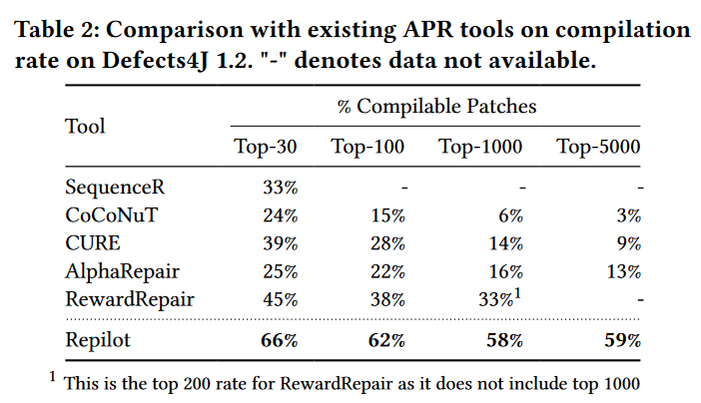
RQ2: How effective is Repilot in improving the compilation rate of patch generation?

Slide 33
RQ2: How effective is Repilot in improving the compilation rate of patch generation?
Repilot has the highest patch compilation rate out of the other APR tools, implying Repilot generates more compilable patches.
Repilot also maintain its compilation rate with higher number of generated patches, unlike other APR tools which drop significantly with higher number of generated patches.

Slide 34
RQ3: Are all components of Repilot making positive contributions to its effectiveness?

Slide 35

RQ3: Are all components of Repilot making positive contributions to its effectiveness?
: using only the base LLM for patch synthesis.

Slide 36

RQ3: Are all components of Repilot making positive contributions to its effectiveness?
: using only the base LLM for patch synthesis.
: Include Completion Engine to prune infeasible tokens.

Slide 37

RQ3: Are all components of Repilot making positive contributions to its effectiveness?
: using only the base LLM for patch synthesis.
: Include Completion Engine to prune infeasible tokens.
: Include Completion Engine for pruning and Memorization

Slide 38

RQ3: Are all components of Repilot making positive contributions to its effectiveness?
: using only the base LLM for patch synthesis.
: Include Completion Engine to prune infeasible tokens.
: Include Completion Engine for pruning and Memorization
: Include Completion Engine, Memorization and Active Completion.

Slide 39
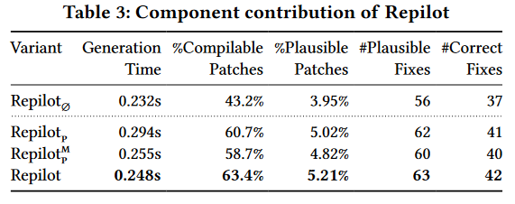
RQ3: Are all components of Repilot making positive contributions to its effectiveness?

Slide 40
RQ3: Are all components of Repilot making positive contributions to its effectiveness?
Pruning contribute to higher patch compilation rate, number of plausible patches and number of correct patches
Memorization contribute to faster generation time
Active Completion contribute to overall performance of APR
faster generation time
higher patch compilation rate
higher number of plausible patches
higher number of correct patches

Slide 41
RQ4: Can Repilot generalize to different subjects of bugs and models?

Slide 42
RQ4: Can Repilot generalize to different subjects of bugs and models?
Notation:

Slide 43
RQ4: Can Repilot generalize to different subjects of bugs and models?
Notation:
Datasets used:
Defects4J 1.2
Defects4J 2.0

Slide 44
RQ4: Can Repilot generalize to different subjects of bugs and models?
Notation:
Datasets used:
Defects4J 1.2
Defects4J 2.0
LLM models used:
CodeT5
Incoder-6.7B

Slide 45
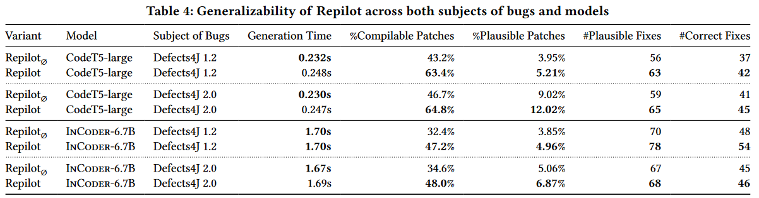
RQ4: Can Repilot generalize to different subjects of bugs and models?

Slide 46
RQ4: Can Repilot generalize to different subjects of bugs and models?
Repilot is able to generalize across different subjects of bugs
Repilot is able to generalize across different models

Slide 47
Conclusion
The authors proposed Repilot — the first APR approach to combining the direct usage of LLMs (e.g., CodeT5 and InCoder) with on-the-fly guidance provided by Completion Engines.
The evaluation on a subset of the widely-studied Defects4J 1.2 and 2.0 datasets, and it shows Repilot is able to achieve the state-of-the-art results.
Repilot is able to generate more valid and compilable patches than prior tools.

Slide 48
Discussion Points (DP)
DP1: Only applicable to language with static checking support
DP2: Repilot can be used with other LLMs, Repilot is a like a framework on top of the LLMs
DP3: The LLM model used also influences the patches generated here. So, the better quality LLM can give better performance.

Slide 49
Q&A

